Slide 1





Advantages of Wind Energy
Wind is a type of clean energy
Wind is a renewable energy source
wind power has a low operating cost
wind power generation creates new jobs

Slide 2
Advantages of Wind Energy
Wind is a type of clean energy
Wind is a renewable energy source
wind power has a low operating cost
wind power generation creates new jobs

Slide 3
Advantages of Wind Energy
Wind is a type of clean energy
Wind is a renewable energy source
wind power has a low operating cost
wind power generation creates new jobs

Slide 4
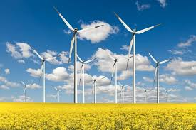
Advantages of Wind Energy
Wind is a type of clean energy
Wind is a renewable energy source
wind power has a low operating cost
wind power generation creates new jobs

Slide 5
Advantages of Wind Energy
Wind is a type of clean energy
Wind is a renewable energy source
wind power has a low operating cost
wind power generation creates new jobs

Slide 6
Advantages of Wind Energy
Wind is a type of clean energy
Wind is a renewable energy source
wind power has a low operating cost
wind power generation creates new jobs

